Slide 1


Slide 2
Engineering Excellence – J1
Hadoop Cluster Setup
05: Mid Sprint Review meeting : 06/24/2016
SPRINT 4 (June 20– July 01)

Slide 3
Last Week’s Action Items
Make sure all the team members should attend weekly calls & DSM. In Progress
Review of product backlog to be done by mentors (Including 30 min of Demo + 30 mins of backlog planning with mentors). Done.
No MOM was sent for 17th review meeting, so plan that somebody from team is already aware of his responsibility to note down the MOM point and circulate later with whole team. Done

Slide 4
Last Week’s Action Items
It was requested in review meeting, to come up with the projection on completed user stories work and remaining user stories work in term of story points. The summary total at bottom of user stories backlog sheet in tracker file was not correct and team has to evaluate if the amount of remaining work can be completed in available timeframe. Done

Slide 5
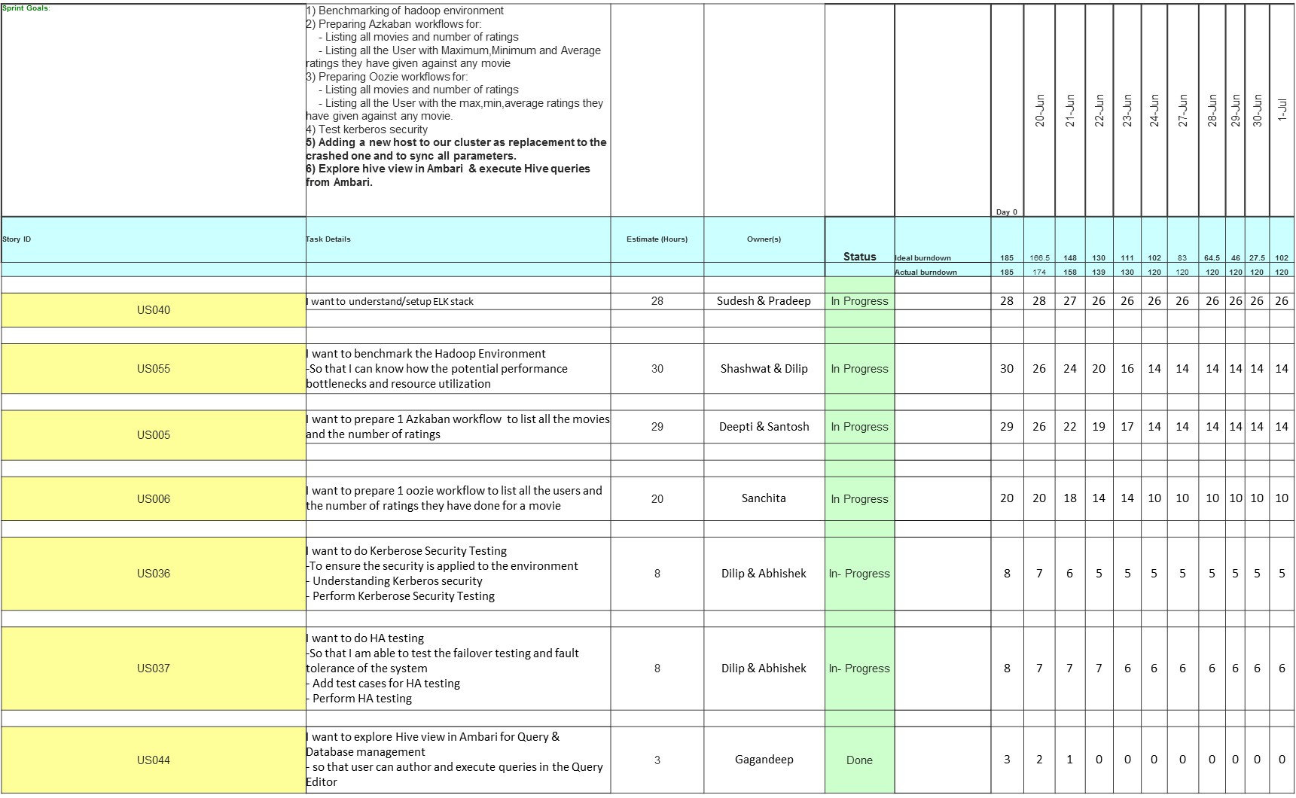
Team Status (Sprint 4)

Slide 6
Team Status (Sprint 4) Continued …
US013 | I want to prepare 1 Azkaban workflow to list all the User with : - Maximum ratings they have given against any movie - Minimum ratings they have given against any movie - Average ratings they have given against any movie | 12 | Gagandeep | In-Progress |  | 12 | 12 | 12 | 11 | 11 | 10 | 10 | 10 | 10 | 10 | 10
US012 | I want to prepare 1 oozie workflow to list all the User with the max,min,average ratings they have given against any movie | 20 | Rupika | In- Progress |  | 20 | 20 | 18 | 18 | 16 | 16 | 16 | 16 | 16 | 16 | 16
US069 | Adding a new host to our cluster as replacement to the crashed one and to sync all parameters. | 4 | Sudesh | Done |  | 3 | 3 | 1 | 0 | 0 | 0 | 0 | 0 | 0 | 0 | 0
US014 | As a Dev I want to prepare 1 oozie workflow to list all the Movies with the max,min,average ratings given by any user So that I can list all the Movies with the max,min,average ratings given by any user. | 10 | OM | In- Progress |  | 10 | 9 | 8 | 6 | 6 | 6 | 6 | 6 | 6 | 6 | 6
US010 | I want to prepare 1 oozie workflow to list all the Users who have rated the movies (Users who have rated atleast one movie) So that I can list all the Users who have rated the movies (Users who have rated atleast one movie). | 5 | OM | Not- Started |  | 5 | 5 | 5 | 5 | 5 | 5 | 5 | 5 | 5 | 5 | 5
US057 | I want to test Azkaban workflow which list all the movies and the number of ratings | 9 | Ravi | In- Progress |  | 9 | 9 | 9 | 8 | 8 | 8 | 8 | 8 | 8 | 8 | 8

Slide 7
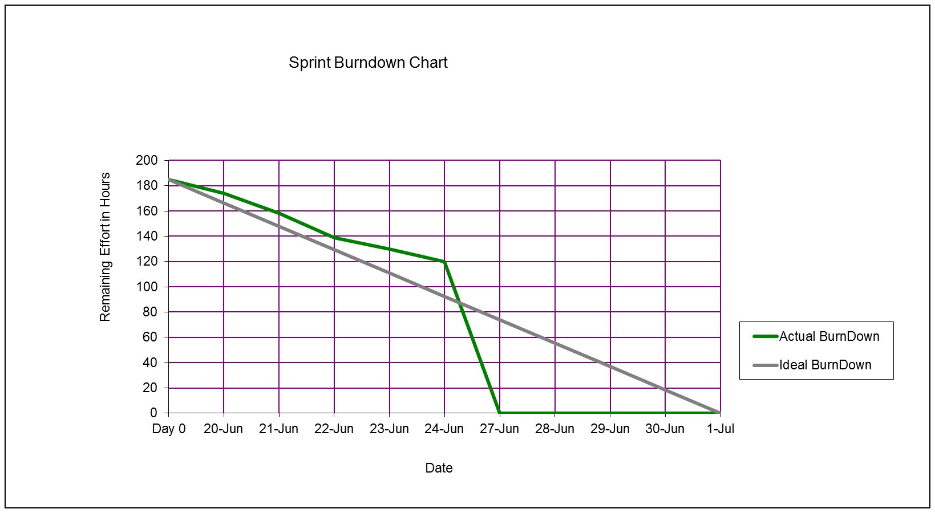
Burn down chart on – 06/24/2016

Slide 8
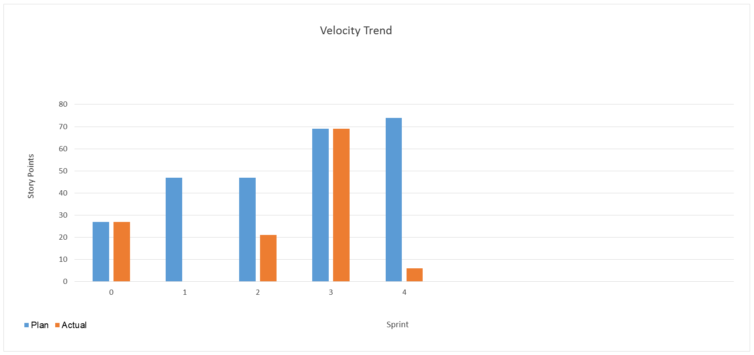
Velocity Trend on– 06/24/2016

Slide 9
Thanks

